Slide 1
Deep Learning
CA1
Ernest Ng P2222668 DAAA2B06

Slide 2
01
Convolutional Neural Networks

Slide 3
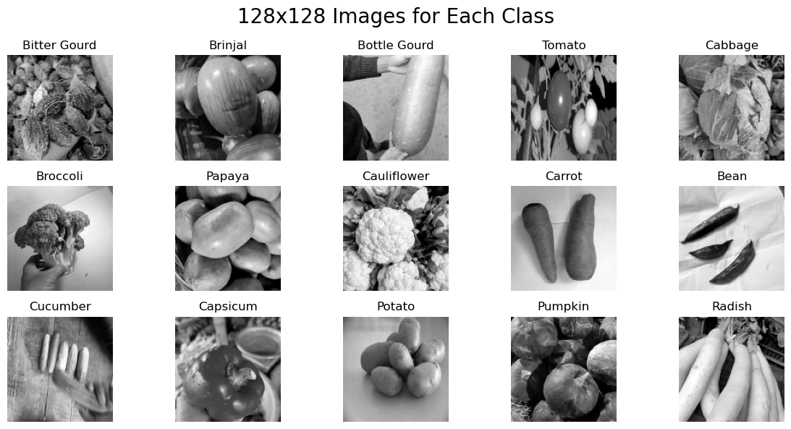
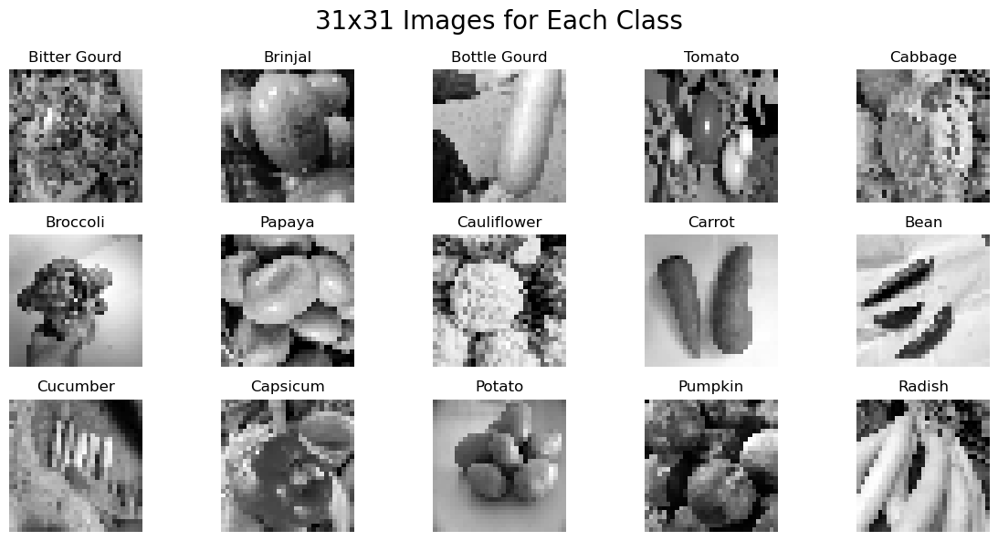
EDA
We will be training 2 models for 2 different image sizes. 128x128 and 31x31
We can observe that in the decrease of resolution, our 31x31 images are much harder to differentiate than 128x128 images.

Slide 4
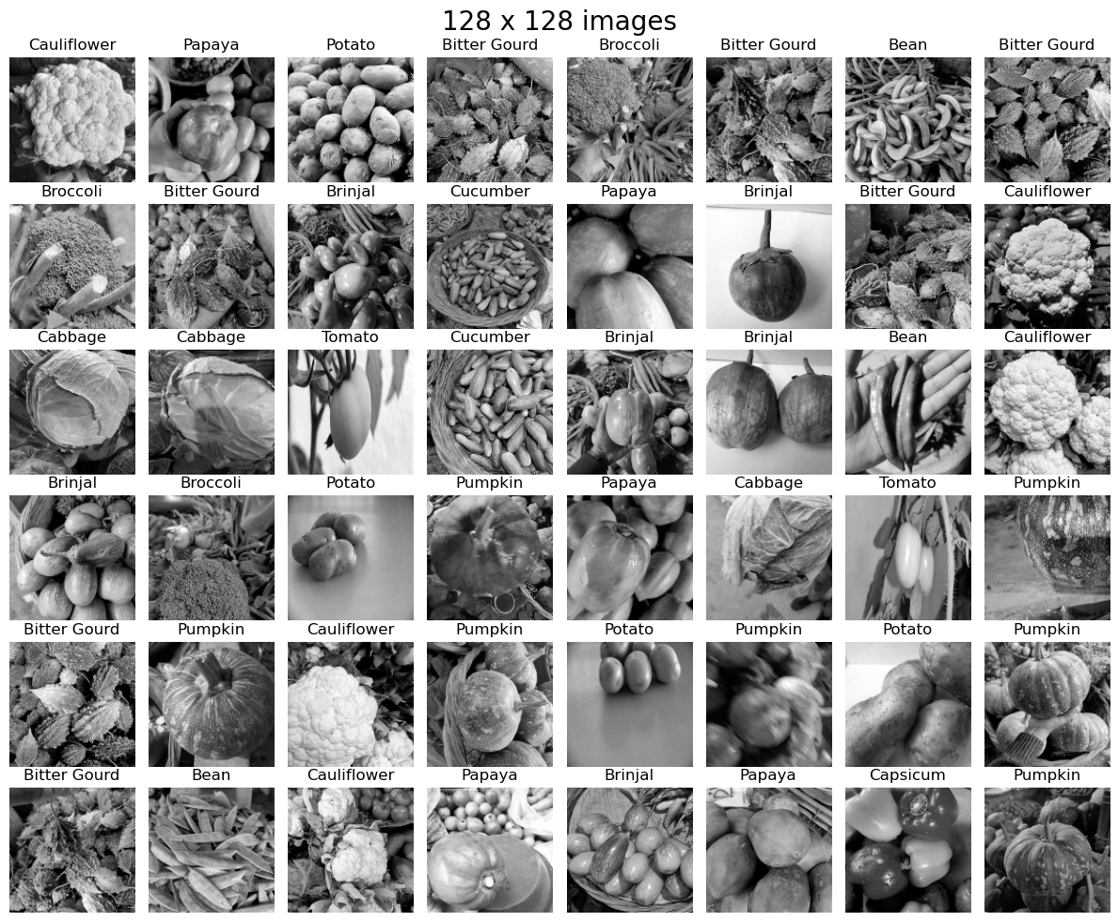
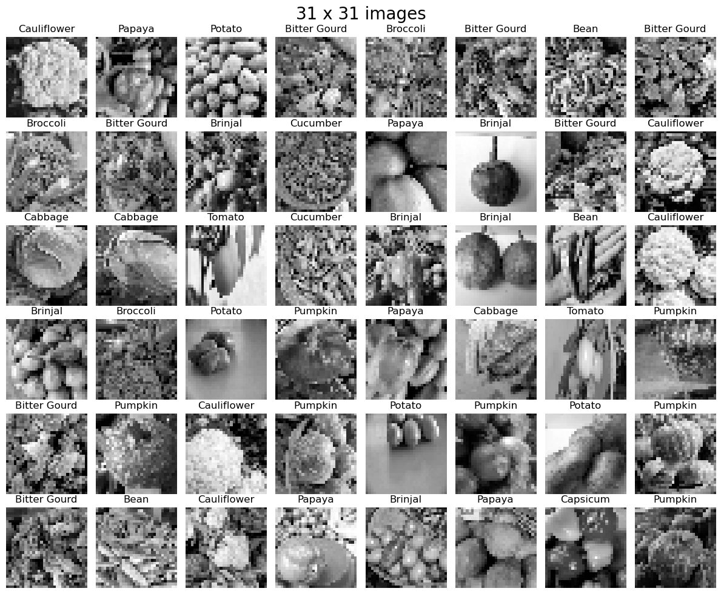
EDA
There is quite a lot of variations among our classes, with vegetables being quite hard for a human to differentiate them perfectly.
There are even some images taken quite blurry even in 128x128 resolution.

Slide 5
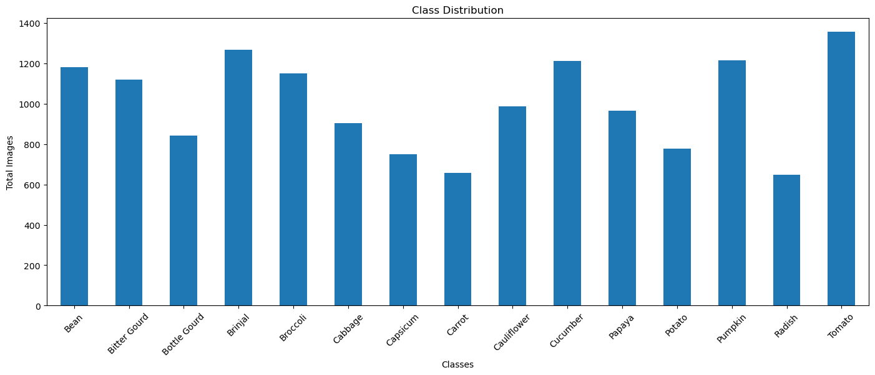
EDA
When checking our image class distribution, we notice that we have a class imbalance for our train dataset.
To solve this we will be assigning different weights to different classes. As it helps preserve our data, prevent overfitting and it is a easier technique to do than image oversampling.
Class Weights: {0: 0.042979263, 1: 0.046560865, 2: 0.07601774, 3: 0.038621914, 4: 0.04469843, 5: 0.06664775, 6: 0.09550946, 7: 0.13095243, 8: 0.05711043, 9: 0.041285496, 10: 0.05922937, 11: 0.088922605, 12: 0.041184057, 13: 0.1351767, 14: 0.03510348}

Slide 6
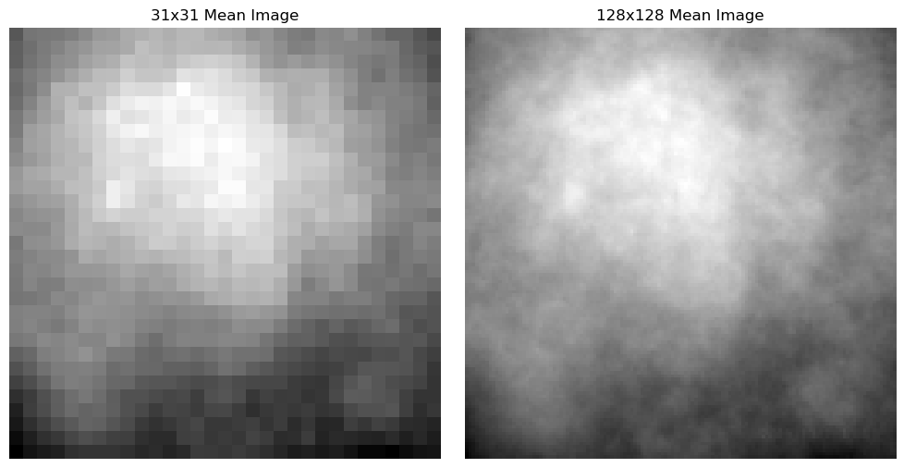
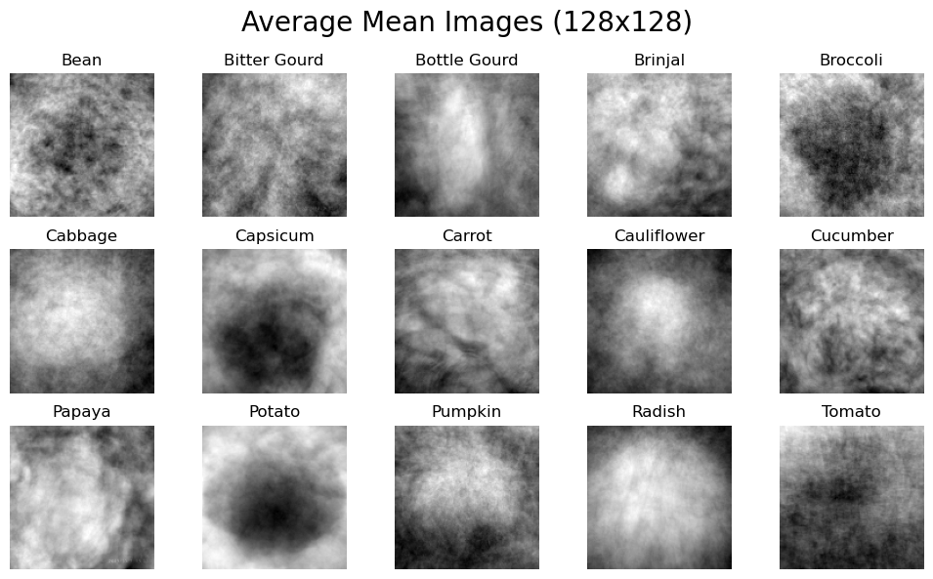
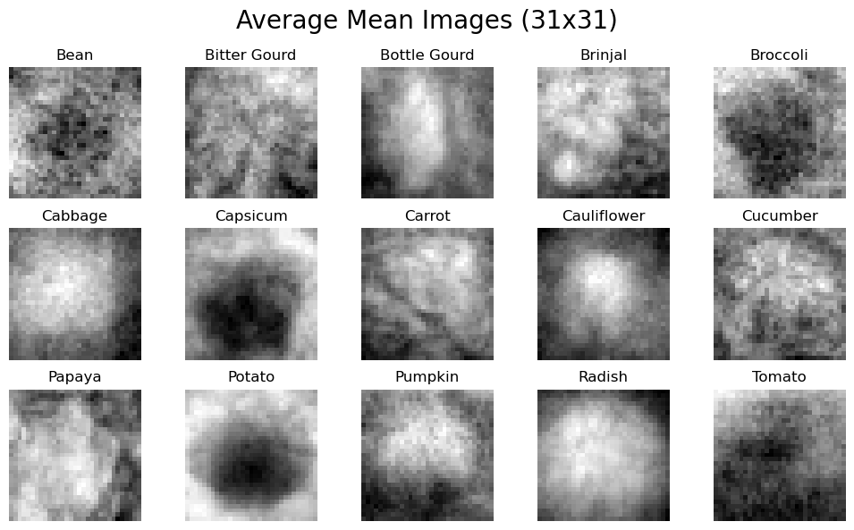
EDA
Image Averaging
We will apply a technique called Image Averaging. It stacks all images in the dataset and average each other. This allows us to look at the noise of the dataset and all images per class.
The images for each class are not very clear, however we can see the rough outline for each class indicating where the vegetable is.

Slide 7
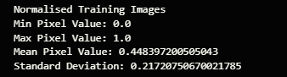
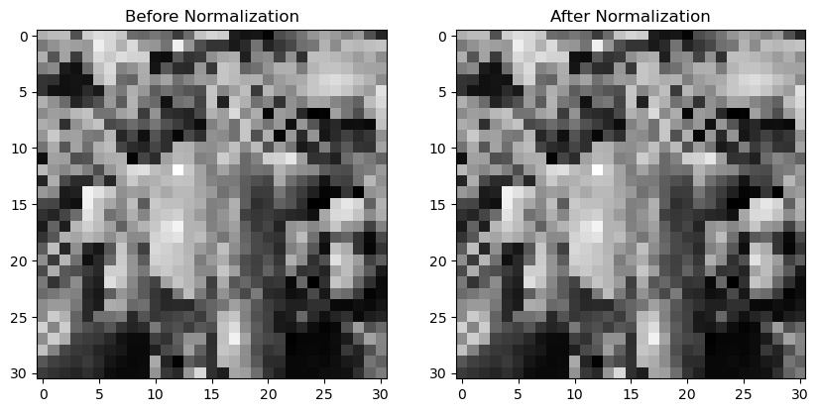
Data Preprocessing
We will be normalising our images to help our model achieve faster convergence and helps it generalise better.
We can see that normalising does not affect the image much as the original pixel values were already in the same range as before

Slide 8
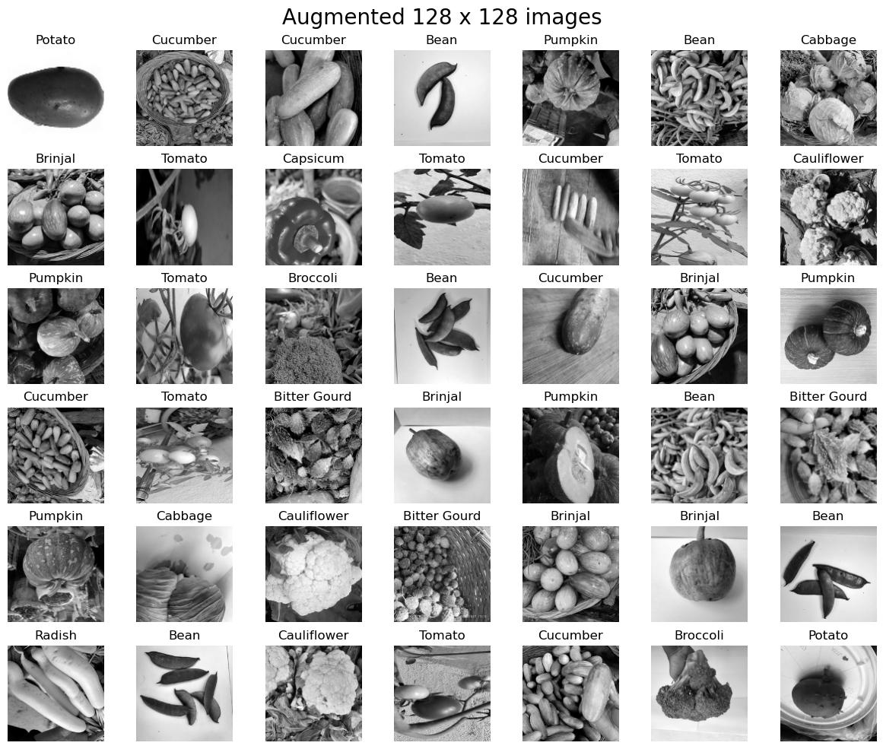
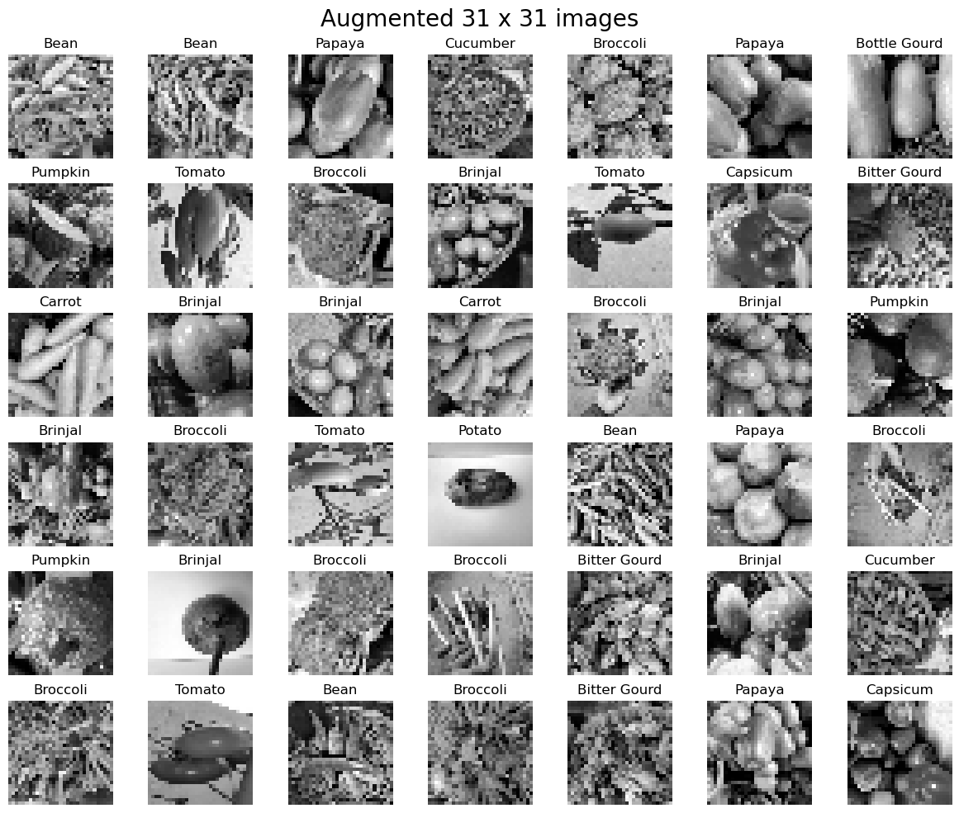
Data Augmentation
We will be augmenting our dataset, to include a greater range of variations in our images, thu helping our model to prevent overfitting.
We will be doing simple data augmentation on our images, flipping both horizontally and vertically and cropping our images

Slide 9
Building our Models
We will be experimenting with the different CNN model architectures to see which one best suits our image dataset.
Conv2D Neural Networks(Base)
Custom VG16 Network
Custom Resnet Network
We will be choosing SGD from adam, as SGD updates it learning rates individually for each weights where adam does not preserve the details when distinguishing an image.
We will be using Early Stopping to prevent our model from overfitting.

Slide 10
Does size matter?
With different image size, we need to build our models in accordance to our input sizes.
As larger input sizes, tend to need deeper neural networks to better capture the greater amount of details in the image. However with great power comes great responsibility, our ;large inputs are more prone to overfitting due to the model memorising specific details from the training set and failing to generalize to new data,
Summary:
Smaller input sizes give faster training times and is able to generalise better
Larger input sizes require increased model complexity and more prevention to overfitting as compared to smaller input sizes.

Slide 11
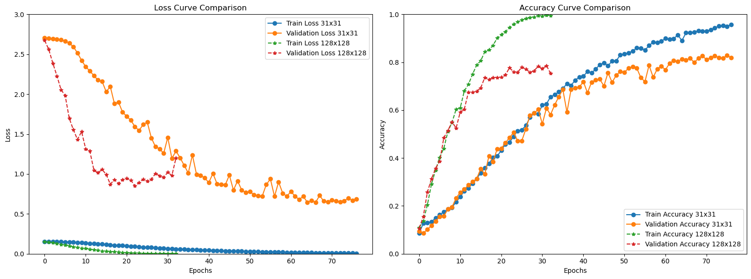
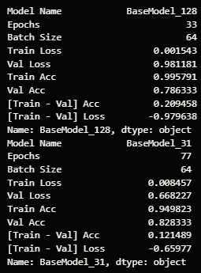
Conv2D Base model
We can see that our 128x128 does overfit alot more as compared to our 31x31 model.
From the loss curve, we see that the model becomes generalised and loss functions starts to decreases. However, there are spikes and sudden drops in the accuracy.

Slide 12
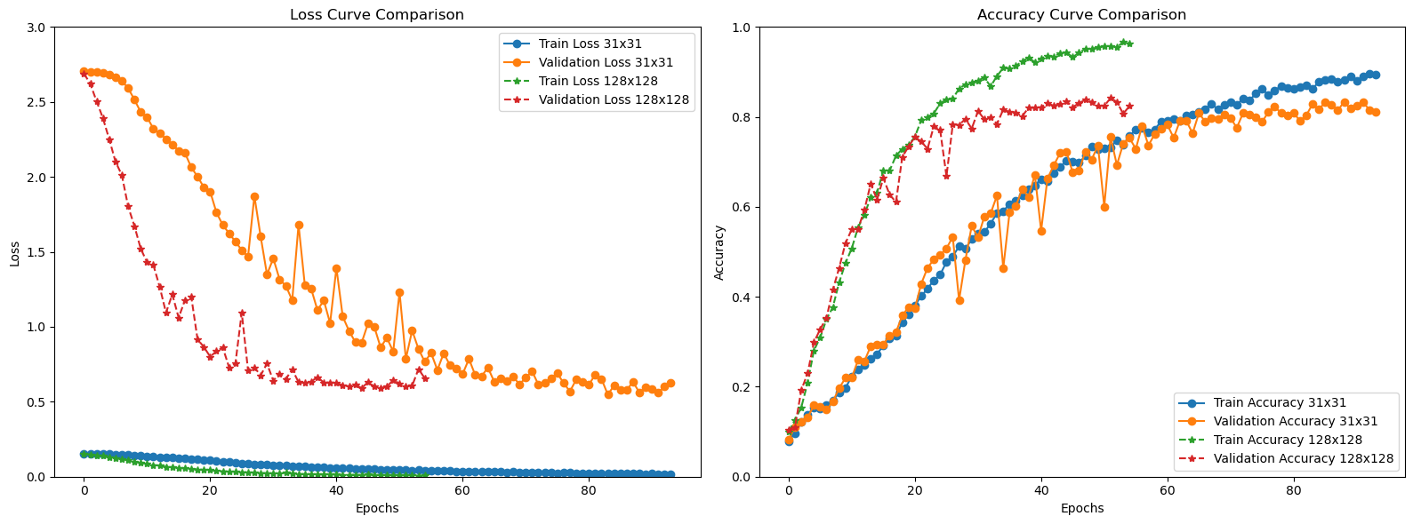
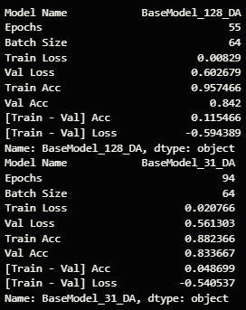
Con2D - Data Aug
When we compared the dataset with added variations, the model didn't do as well—it became less accurate. This could be because the validation data didn't have those extra variations, and the changes we made didn't really help the model understand patterns better. It suggests that tweaking the data might not be the best way to make the model more accurate.

Slide 13
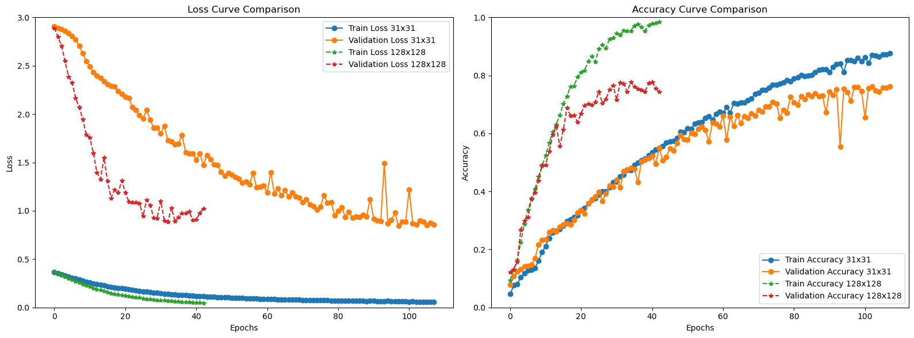
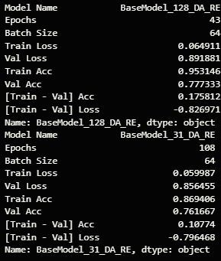
Con2D - Data Aug & L2 regularization
Upon introducing L2 Regularization, we observe a notable reduction in overfitting across our models in comparison to the base. Remarkably, the 31x31 model displays significant improvement when trained on the augmented dataset. However, the 128x128 model not only fails to improve but also exhibits a decline in performance when compared to training solely on augmented images.

Slide 14
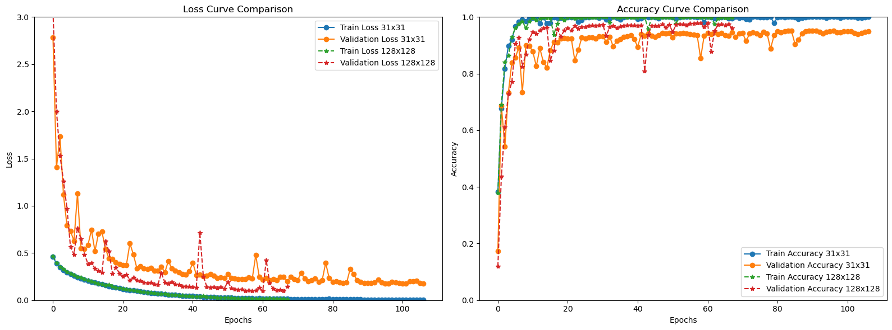
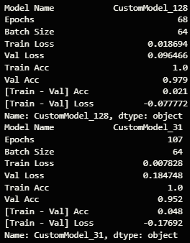
Custom VG16 Model
We will be building a Custom CNN model based on the VG16 model architecture. With our 31x31 model having 9 layers and 128x128 model having 12 layers.
We can see that we have considerably improved on our baseline,our model is able to predict and classify the images better with higher accuracy and is generalising the data.

Slide 15
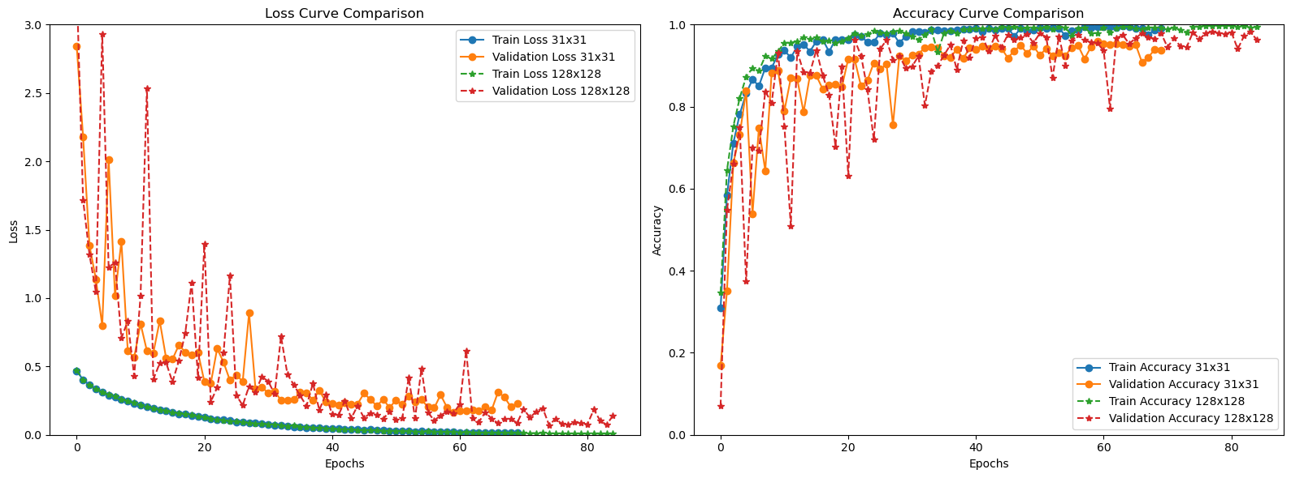
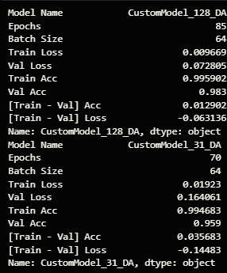
Custom VG16 Model - Data Aug
Introducing both data-augmented images and a dropout layer has resulted in increased fluctuations in our accuracy and loss graph. It can be attributed to the inherent variability introduced by Data Augmentation, where random transformations are applied to training images, contributing to increased dataset diversity.
The incorporation of Data Augmentation, however, has proven effective in preventing overfitting compared to our custom model trained on non-augmented images.

Slide 16
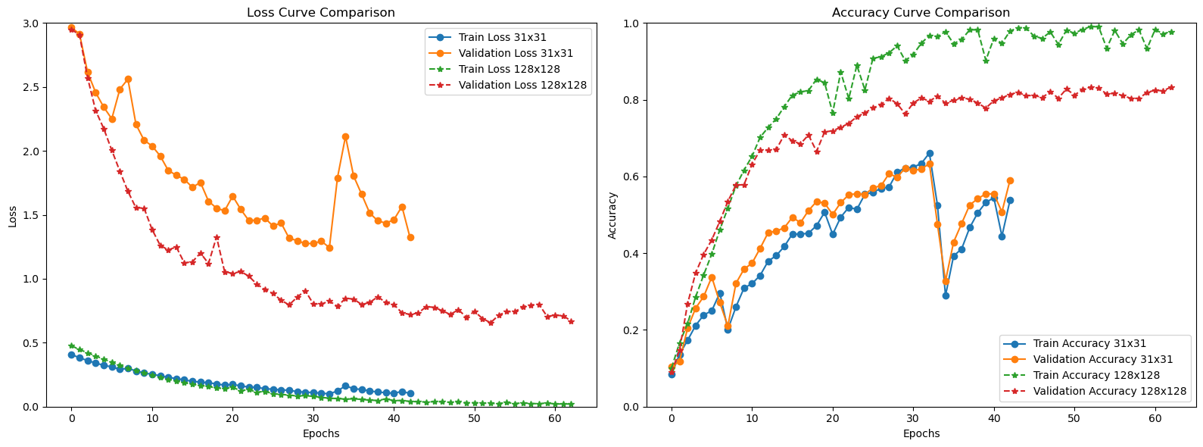
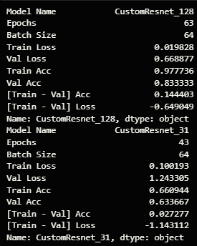
Custom Resnet
We will be using a 12 layered resnet for our 31x31 images and a 16 layered resnet for our 128x128 images.
Examining our loss curves, both models exhibit signs of overfitting.Notably, in the case of the 31x31 model, the accuracy graph reveals a peculiar behavior where the validation curve closely follows the train accuracy curve. This might be attributed to the limitation of accuracy as a metric for detecting overfitting in this scenario. The complexity of our model in relation to the 31x31 images could render accuracy less sensitive to overfitting signals.

Slide 17
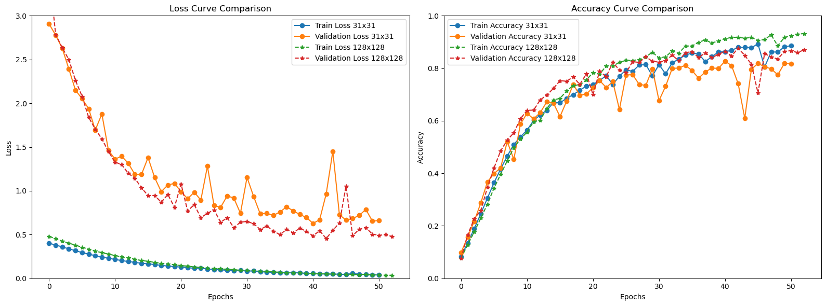
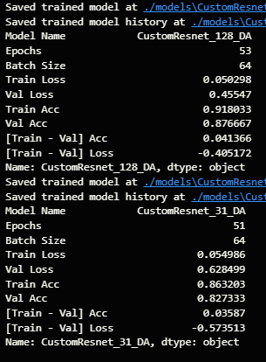
Custom Resnet - Data Aug
We have decreased our model complexity from 12layers to 9 layers in our 31x31 model.
After using data augmentation, our models got much better, especially the 31x31 one. This improvement happened because we made the model simpler and added more varied data.
Both the 128x128 and 31x31 models show better results in their loss curves when we use data augmentation.

Slide 18
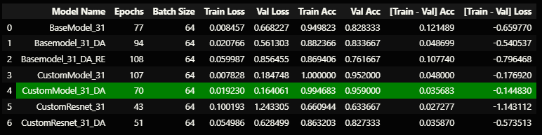
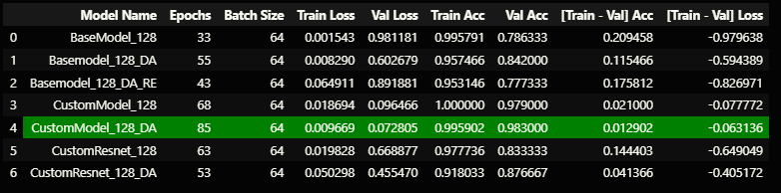
Chosen Model
Our custom CNN model based on VG16 architecture, has the best overall results among the models we have tested.
There doesn't seem to have a lot of overfitting as compared to the rest of the models for both 31x31 and 128x128
Why does VG16 have better results even though Resnet has been proven better?
This might be because our custom ResNet model only has 12 layers (for 128x128), while current ResNet models like ResNet34 and ResNet50 have more layers. ResNet is good at handling really deep neural networks because of its skip connections. However, we can't train a large custom ResNet model with 34 to 50 layers due to hardware and time limitations.

Slide 19
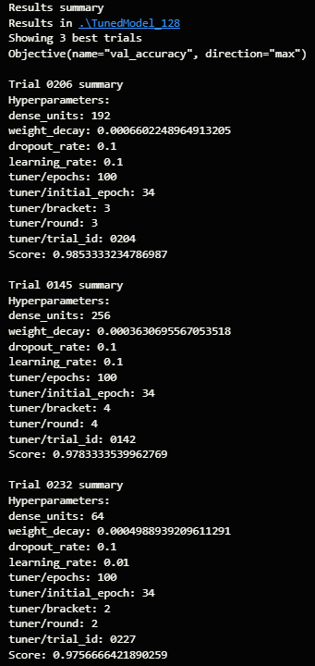
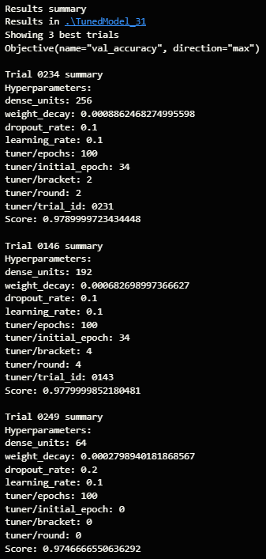
Model Improvement
We will be tuning the parameters learning rate, number of neurons and weight decay values using Keras tuner to gridsearch the available parameters.
After finding the best weight decay values through hyperparameter tuning, our model's test accuracy has improved by over 2%.
Notably, we observed that our model performs better and converges more effectively with larger learning rate values. The top 3 results for both the 128x128 and 31x31 models selected a learning rate of 0.1 for their parameters.

Slide 20
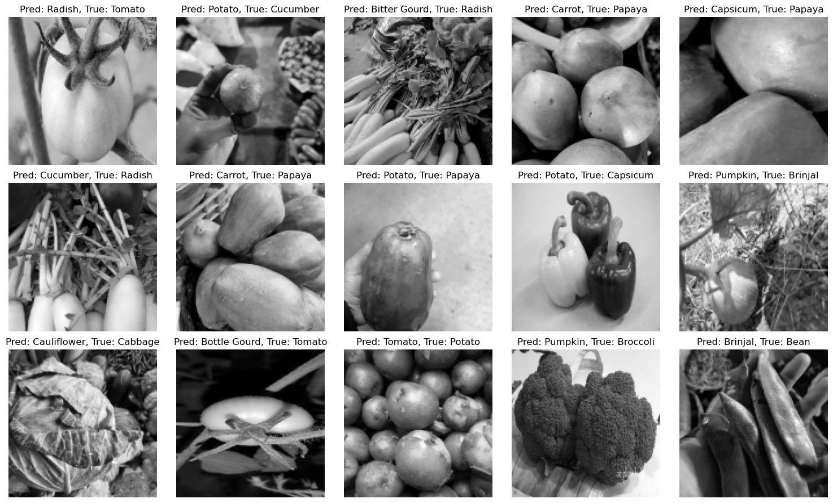
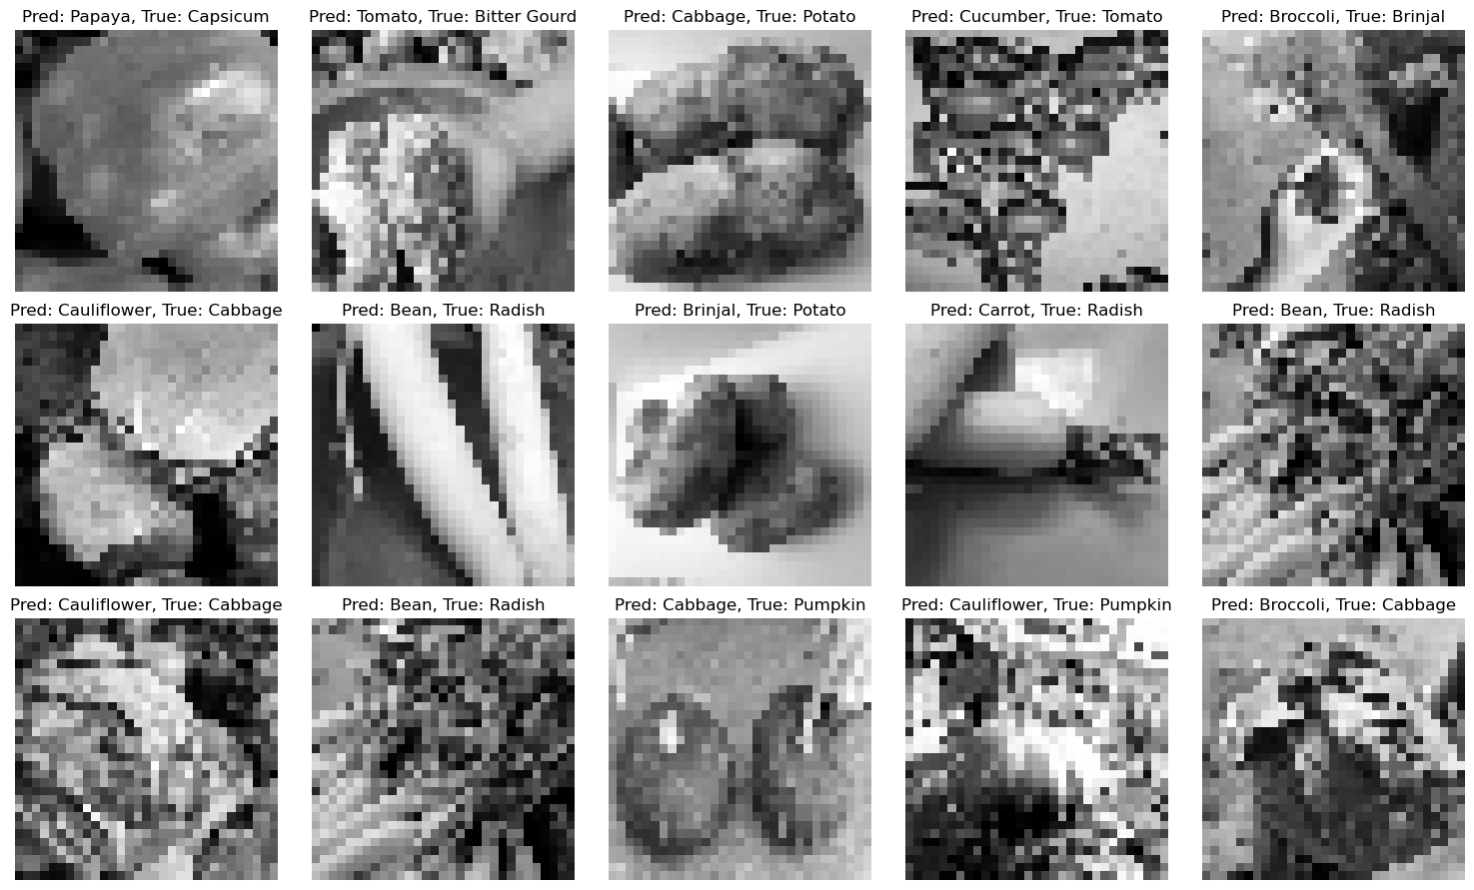
Error Analysis
Observations for the 128x128 Model:
Sometimes, the mistakes made by the model seem a bit silly, like confusing a papaya with a carrot. This suggests that we might need to make our 128x128 model deeper and more complex to understand vegetables better.
However, some mistakes, like confusing papayas with potatoes in black and white images, are reasonable. This shows that factors like color and image quality impact the model's performance, not just its architecture.
Observations for the 31x31 Model:
The low pixel resolution makes it hard even for a person to tell what some vegetables are. At this size, important details and features that define different vegetables might be missing or hard to see.
So, it's okay for the model to make these kinds of mistakes. Overall, our model is doing well, considering that some errors come from the natural difficulty of interpreting small images.

Slide 21
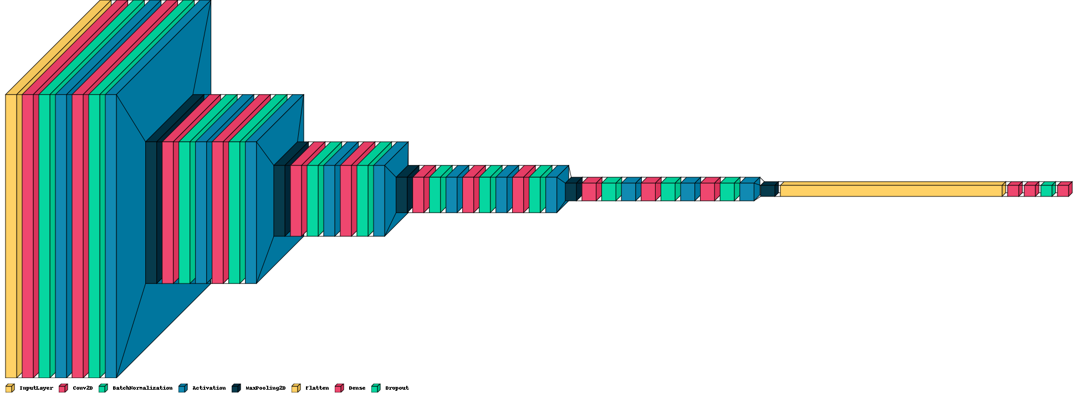
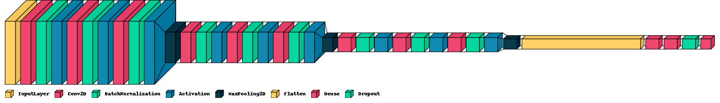
Model Visualisation

Slide 22
Summary
In summary, I experimented with various models, and found that a custom built CNN with batch normalization and data augmentation to try to reduce overfitting. More room for improvement can be made to the model like increasing the number of layers, trying different model architecture using different learning rates and optimizers like RMSProp and Ftrl can be done to make model better.

Slide 23
Thanks
Do you have any questions?
your email@freepik.com
+91 620 421 838 yourcompany.com
Please keep this slide for attribution

